Slide 1


APPLICATION OF MATRICES IN COMPUTER GRAPHICS
K. J. SOMAIYA COLLEGE OF ENGINEERING, MUMBAI – 400 077
(A CONSTITUENT COLLEGE OF SOMAIYA VIDYAVIHAR UNIVERSITY) DEPT. OF SCIENCE AND HUMANITIES
F.Y. B. TECH. SEMESTER –I (2022-23)
APPLIED MATHEMATICS-I
IA-I
NAME :AAKRITI MEHTA
ROLL NO. :16010122109
DIV: 2 BATCH: C2-2

Slide 3
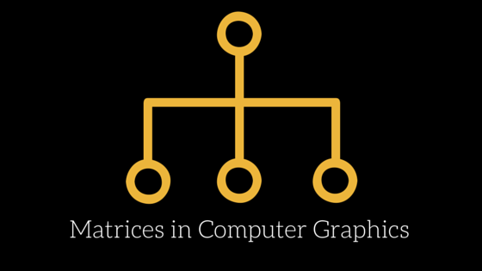
AMONGST ALL THE COMMON TOOLS IN ENGINEERING ARE RECTANGULAR GRIDS KNOWN AS MATRICES WHICH REPRESENTS DATA OR MATHEMATICAL EQUATIONS.
BY MULTIPLYING MATRICES WE CAN GET A QUICK AND GOOD APPROXIMATIONS OF COMPLICATED CALCULATIONS.
MATRICES PLAYS AN IMPORTANT ROLE IN CONVERTING THREE DIMENSIONSAL IMAGE TO TWO DIMENSIONAL IMAGE.
MATRICES IS USED TO PROCESS LINEAR TRANSFORMATIONS TO MAKE IMAGES.
IN COMPUTER GRAPHICS EVERY ELEMENT IS REPRESNETED BY A MATRIX.
The usefulness of a matrix in computer graphics is its ability to convert geometric data into different coordinate systems.

Slide 4
Computer graphics is a computing field that involves the creating, storing and processing of image content via computer. It has a wide application in science, engineering, art and especially in the field of entertainment, movies and video games.COMPUTER GRAPHICS IS USED FOR VARIOUS EDUCATIONAL PURPOSES.
MATRIX IN COMPUTER GRAPHICS PROVIDES A SIMPLE INTERFACE TO STUDY 2D GRAHICS.
BY USING MATRIX IN COMPUTER GRAPHICS WE CAN EASILY DO ANY OF THESE TRANSFORMATIONS ( SCCALING,SHEAR,REFLECTION, ROTATION, TRANSLATION).
GAMES THAT INVOLVE 2D OR 3D GRAPHICS RELY ON MATRIX OPERATION.

Slide 5
THUS, WE CAN DRAW THE DESRIED OBJECT BY USING THE DETERMINED MATRIX BY APLYING THE NECESSARY GEOMETRIC TRANSFORMATION.
MATRIX IS USED IN IMAGE PROCESSING,COMPUTER GRAPHICS,ENCRYPTION AND DECRYPTION OF THE CODES

Slide 6
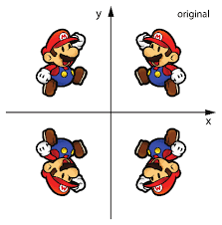
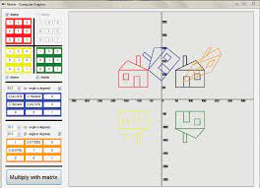
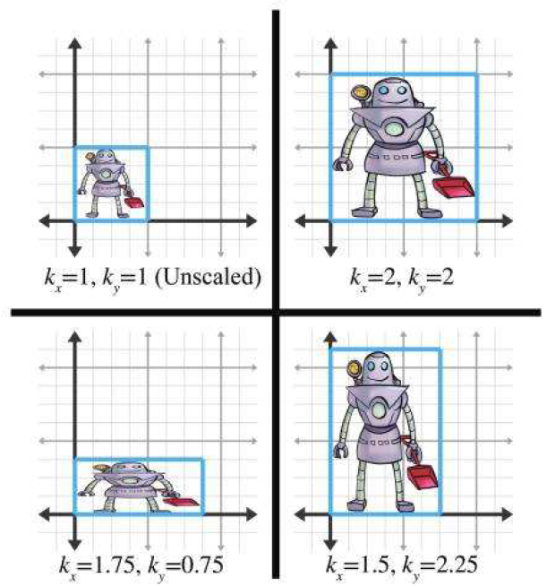
https://www.careers360.com/
https://www.vedantu.com/
https://www.haroldserrano.com/
https://hrcak.srce.hr/
https://www.researchgate.net/

